Slide 1
Image edge information extraction system based on FPGA
基于FPGA的图像边缘信息提取系统
汇报人：陈思佑 张旭东
2023.04.03

Slide 2
CONTEN TS
System framework
Module design
Results

Slide 3
System Framework
01
03
01

Slide 4



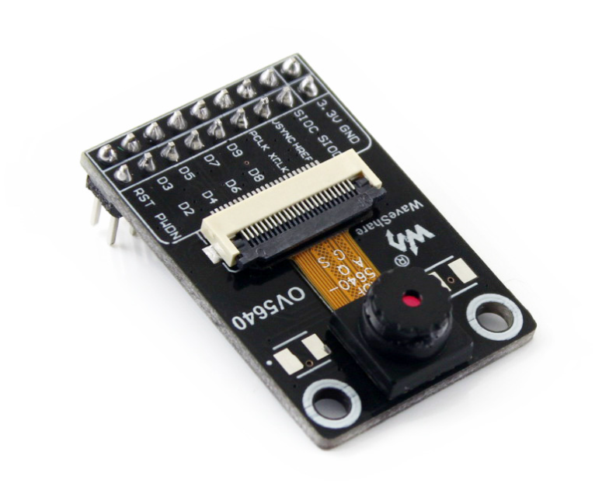
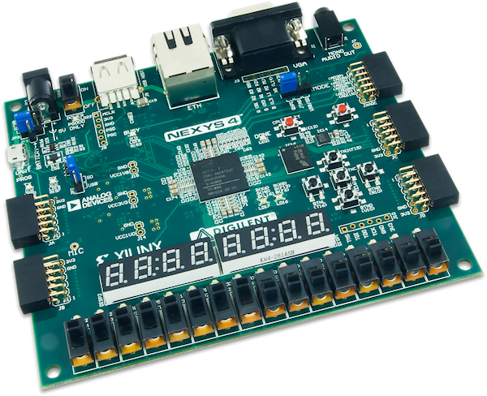
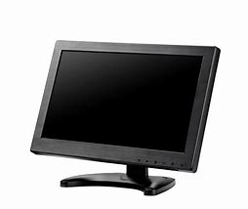
Hardware structure
OV5640 Camera
Nexy4 DDR
VGA displayer

Slide 5
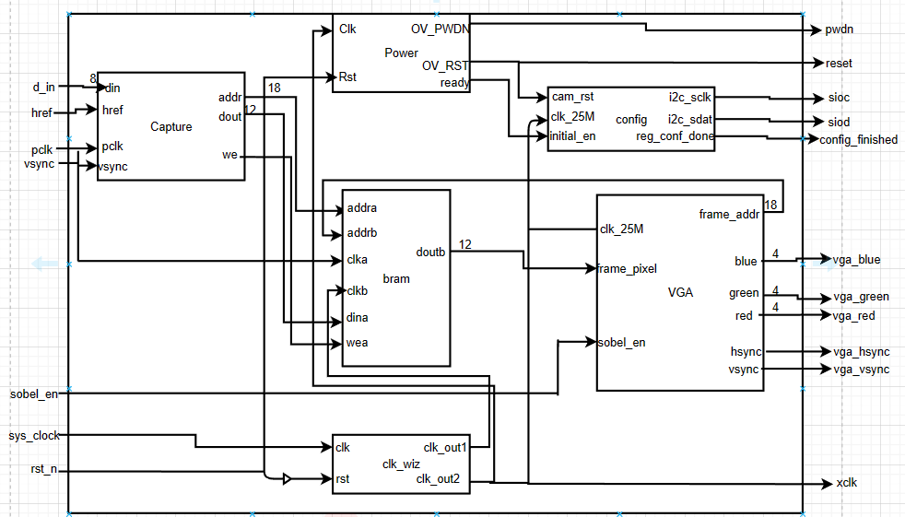
System structure

Slide 6
02
03
Module Design
02

Slide 7
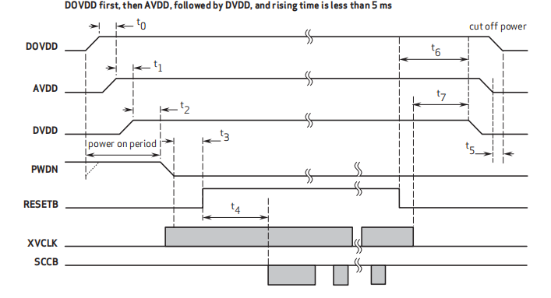
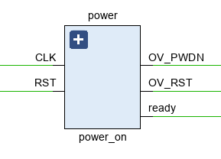
OV5640 Power on Module
OV_PWDN, OV_RST
Output to the camera
Use the counter and clock for timing, power on 6MS after the PWDN flat pull down, 2MS after the RESET pull up signal, 21MS after the output of ready signal, indicating that you can start to configure registers through SCCB protocol

Slide 8
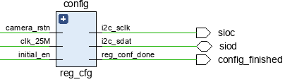
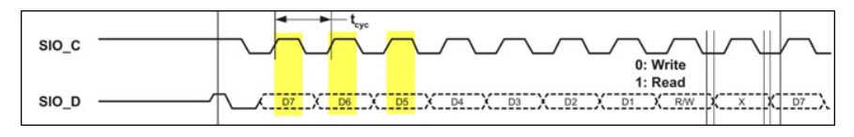
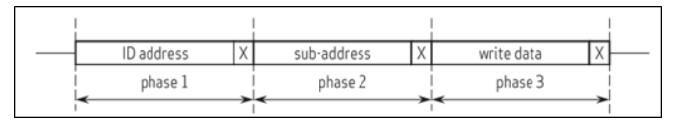
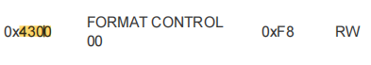
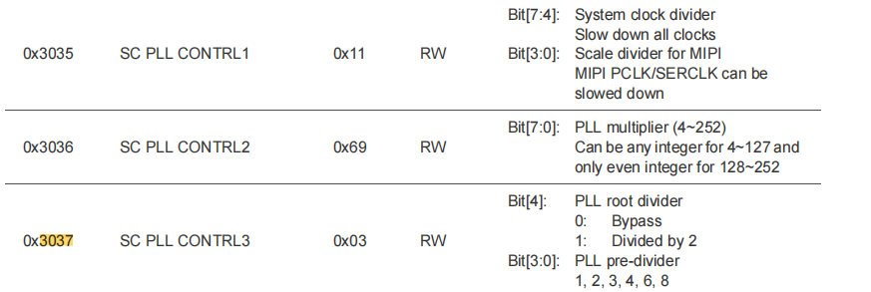
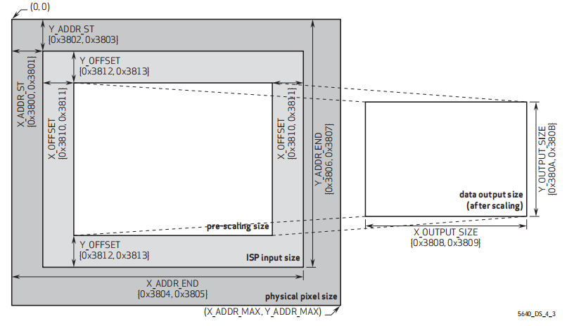
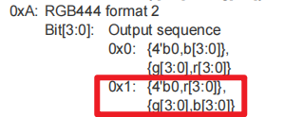
OV5640 SCCB and Register config Module
SCCB sequence diagram
Initial signal: When SIO_C is at high level and SIO_D appears a falling edge, SCCB begins transmission.
Stop signal: When SIO_C is at high level and SIO_D appears a rising edge, SCCB stops transmission.
Valid data: SIO_D is valid at SIO_C high voltage
Transmission data format (write)
Three-step write operation
Phase1: Device address [7:1] Read/Write [0] 1 Read/write
Phase2: operation register address [15:0]
Phase3: Write data [7:0]
Configure the output image size
Configure the output pixel format
Configure the PCLK clock

Slide 9
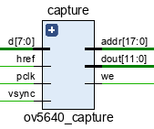
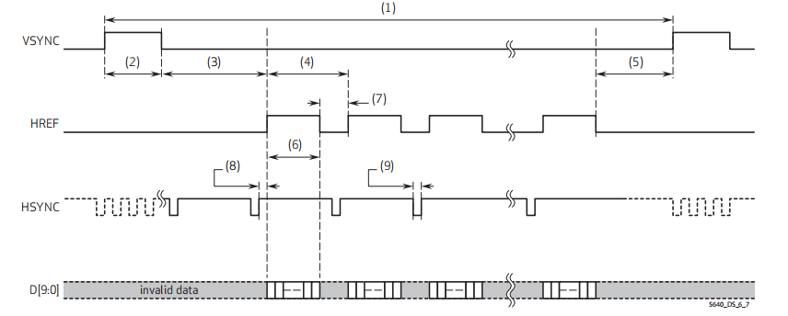
OV5640 Image Capture Module
Formet: RGB444 (2 pclk 1 pixel)
VSYNC: Output a frame of image and then pull it up
HREF: Print a line of the image then pull it up
D: Store it in BRAM, and the size is 640*480
Complete data：”0000RRRRGGGGBBBB”
Write any bits that do not contain 0 bits into memory after reading the data in its entirety

Slide 10
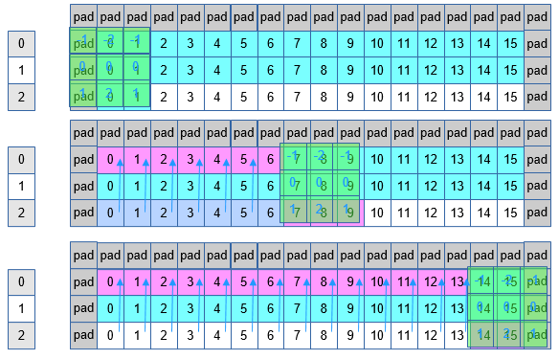
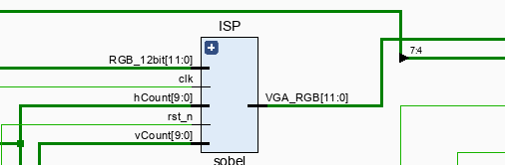
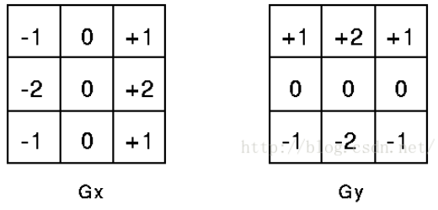
Edge extraction algorithm
Sobel operator
Three shift registers of length 640 are used to store the first three rows (only the first two rows are actually stored), and the pixel value of the current point is calculated when the third pixel of the third row is entered. When the value calculated by sobel is greater than the threshold value, it is considered as the edge.

Slide 11
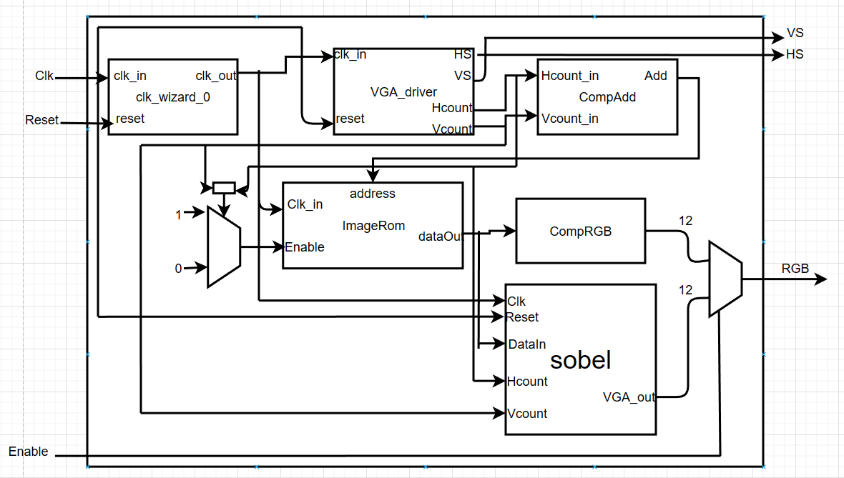
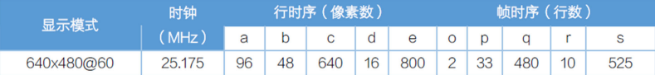
VGA display

Slide 12
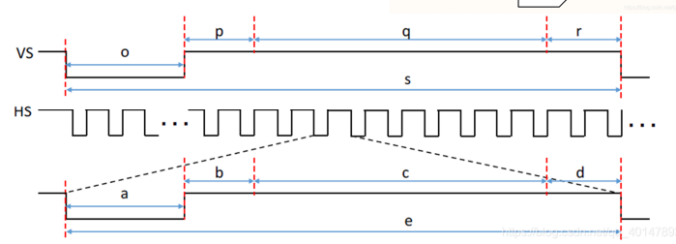
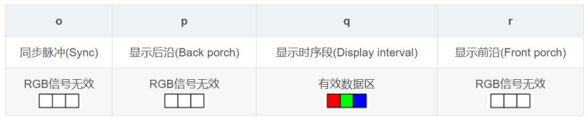
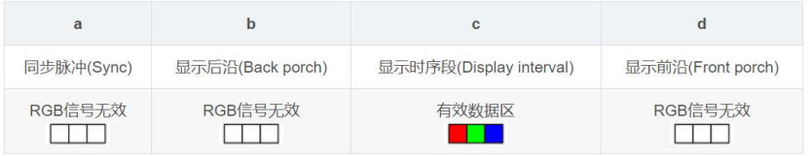
VGA display

Slide 13
04
05
Results
03

Slide 14
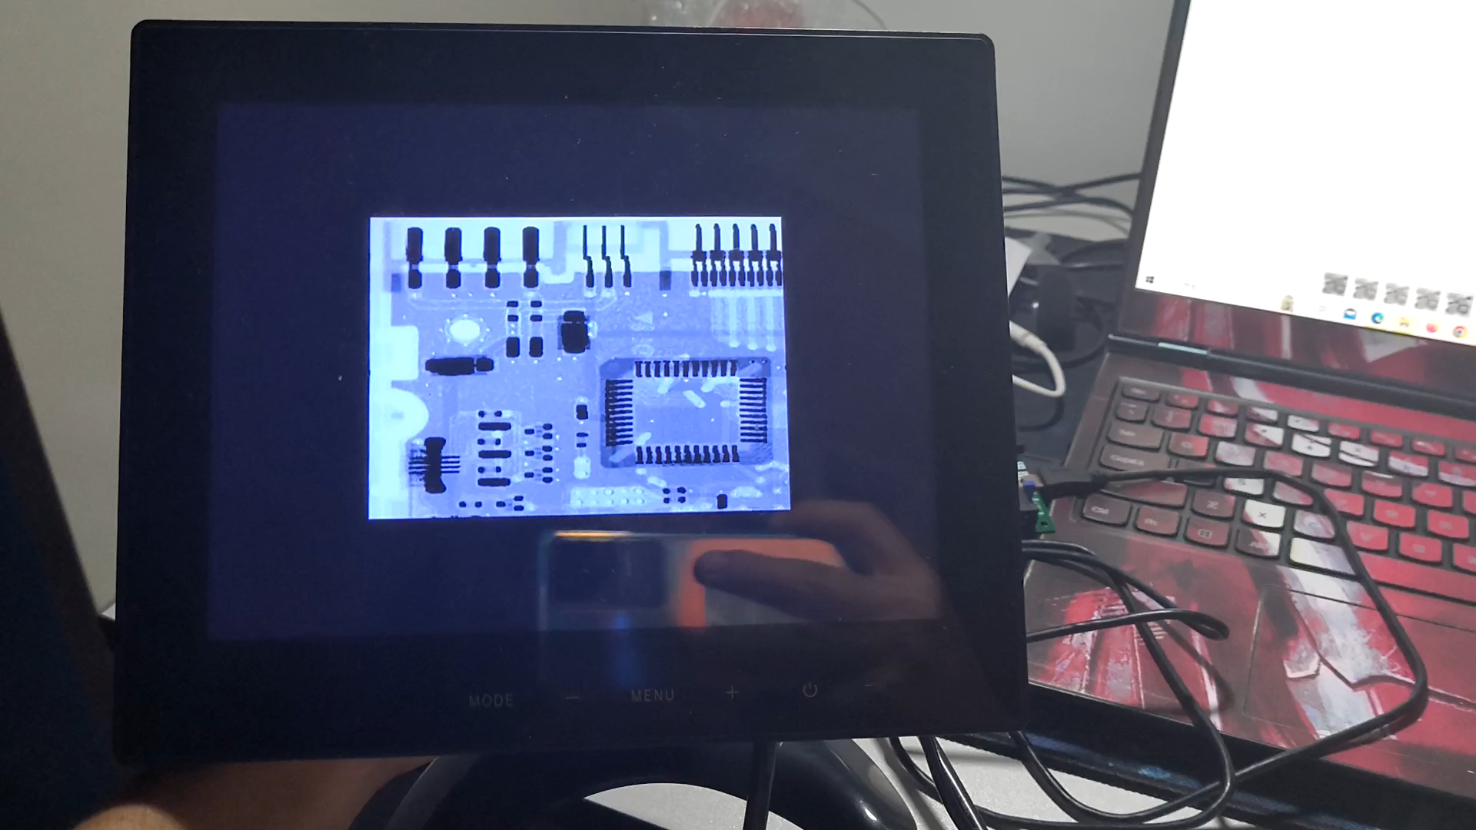
VGA display

Slide 15
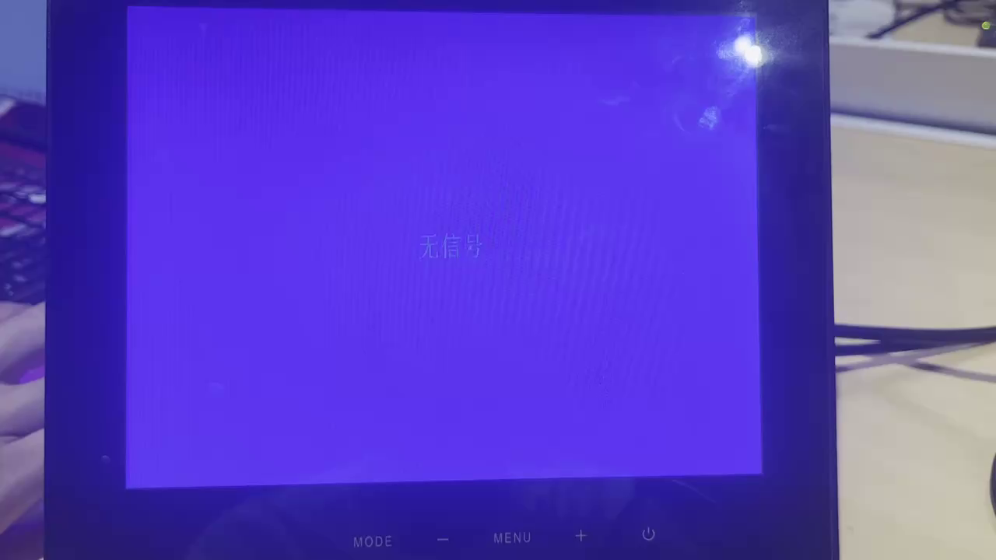
Image edge information extraction system

Slide 16
Thanks !
05
05

